Slide 1
NETSUITE- TECHNICAL TRAINING

Slide 2
Training Content
Day 1- SuiteScript API Overview
Day 2- Interacting With NetSuite Data
Day 3- Script Types
Day 4- Client Script
Day 5- User Event Script
Day 6- Map Reduce Script
Day 7- Suitelet Script
Day 8- Schedule Script
Day 9- RESTLet Script
Day 10- Portlet Script and Bundle Installation Script
Day 11- Mass Update Script and Workflow Action Script
Day 12- Debugging Scripts
Day 13- Best Practices
Day 14- Q & A
Day 15- Final Review and Conclude

Slide 3
Day 1- SuiteScript API Overview
What is Suite Script?
What is use of Suite Script?
What is Suite Script API?
How to run Script in Net-suite?

Slide 4
Suite Script Versions
Suite Script 1.0 (nlapiGetFieldValue())
Suite Script 2.0 (record.getField())
Suite Script 2.1 (Latest Version)

Slide 5
What is Suite Script?
Suite Script is Java Script based API that gives developers to extend the Net-suite capabilities through Suite Builder
Suite Script provides unlimited customizability, can trigger industry specific processes based on user events, create or modify data, communicate with external data sources, or string together a multi-step workflow process.

Slide 6
Suite Script Uses
Perform custom business processing when NetSuite records are updated, created, deleted .
Perform custom validations and calculations in the browser.
Create custom user interfaces.
Run batch processes .
Execute Net-Suite searches.
Perform various utility processing such as sending email and faxes, creating and uploading files, or working with XML documents
Create custom dashboard portlets.
Perform processing in target accounts for bundled solutions as part of bundle installation or update.

Slide 7
What is Suite Script API?
API is mainly used to access the information.
The Suite Script API documentation is organized in a few different ways. Depending on how you wish to access the information.
Ex: Suite script functions and Objects.
(Netsuite Help->Type API in search box )

Slide 8
Run script in Net-suite
Creating a JavaScript file for your script.
Uploading the file into Net-Suite.
Creating a Net-Suite “Script” record for your script(Customization→Scripts→New).
Defining script runtime options on a Net-Suite Script Deployment page.

Slide 9
Day 2:
Interacting With Netsuite Data
Scripting Record
Scripting Fields
Scripting Sublist
Sub Records
Online Forms

Slide 10
Working with Records
The Suite Script API includes several Record APIs that interact with the entire NetSuite record object. When you work with Record APIs, you are doing things such as creating, deleting, copying, or loading all elements of a record.
Whether you are working with standard NetSuite records (for example, Sale Order, Invoice, Customer, Vendor) or custom records you have created using Suite Builder, you will use all the same Record APIs to interact with the record object.

Slide 11
Standard Vs Dynamic mode
When you programmatically create a new sales order in dynamic mode, all of the same sourcing behaviors that occur in the UI also occur in your script as each line is executed. As a result, you can obtain sourced, validated, and recalculated field values in “real-time” without first having to submit the record.
When working with records in standard mode, you must submit and then load the record to obtain these same values. In standard mode, all business logic is executed on only after data is submitted.

Slide 12
Working with Fields
The Suite Script API includes several Field APIs you can use to set and get values for built-in NetSuite standard fields, as well as for custom fields. Standard fields are those that come with NetSuite. Custom fields are those that have been created by NetSuite users to customize their accounts. Custom fields are created using Suite Builder point-and-click customization tools.

Slide 13
Working with Fields
Based on location of the field, Netsuite categories following type
Body Fields
Sublist Fields
Many Suite Script APIs allow you to get, set, or search for the value of a particular field. Whether you are referencing a standard field or a custom field, when you reference the field in Suite Script, you will use the field’s internal ID

Slide 14
Working with Sublists
Editor Sublists: The editor sublist allows users to insert/edit/remove lines dynamically prior to submitting the form.
Inline Editor Sublists: you can add/edit/remove lines dynamically prior to submitting the form, you can add/edit/remove lines using the UI or Suite Script
List Sublists: list sublists are not dynamic. The number of line items are fixed and cannot be removed or added on-the-fly though UI customization or through Suite Script.
Static List Sublists: It ad-only sublists, contain static data. These sublists are typically used for displaying associated records/data rather than child records/data.

Slide 15
Working with Sublists
Netsuite Provides several API’s to access the data.
By using Sublist API, you can add , edit and deletes line items.
Ex: nlapiSetLineItemValue(‘item’, ‘item’, 2, ‘22');

Slide 16
Working with Sub Records
A subrecord includes many of the same elements of a standard NetSuite record (body fields, sublists and sublist fields, and so on). However, subrecords must be created, edited, removed, or viewed from within the context of a standard (parent) record.
If you want to create a subrecord to hold data for a record in a sublist, you can do so from a sublist field.
When working with subrecords from a sublist field on the parent record, you will use these APIs if you are working with the parent record in a “current record” context, such as in a user event script or a client script:
If you are loading the parent record using SuiteScript, and you want to create/access a subrecord from a sublist, you will use these methods on the nlobjRecord object:

Slide 17
Day 3-Script Types
Script types can categorized based on where they run(Client Side/Server Side)
We can use API to create type of script type.
The script type are Client, User Event, Map Reduce, Suitelet ,Scheduled , Portlet, Mass Update , Workflow Action and Bundle Installation Scripts.

Slide 18
Day 4- Client Script
Client scripts are Suite Scripts executed in the browser. They can run on most standard records, custom record types, and custom NetSuite pages.
Generally, client scripts are used to validate user-entered data and to auto-populate fields or sub lists at various form events. Such events can include loading or initializing a form, changing a field, or saving a record.
Another use case for client scripts is to source data from an external data source to a field.

Slide 19
Client Event Functions
In NetSuite, client scripts can be executed on some different client-side events. The following are some of the events
User loads a NetSuite form into the browser.
User selects a field or a field is updated.
Field is auto-updated through a sourcing relationship with another field.
User clicks the Submit button on the form.
When user adding line/removing line
Event on every line adding.

Slide 20
Client Script Events
Client Event Type | Parameter | Returns | Description
PageInit | type: the mode in which record accessed(create, edit) |  | This client event occurs when the page completes loading or when the form is reset
saveRecocd |  | Boolean | This client event occurs when the submit button is pressed but prior to the form being submitted. You should always return either true or false from a saveRecord event. A return value of false suppresses submission of the form

Slide 21
Client Event Functions
fieldChanged | type: the sub list internal ID name: the field internal ID |  | This client event occurs whenever a field is changed by the user or by a client side cal
validateLine | type: the sub list internal ID | Boolean | This client event occurs prior to a line being added to a sub list
Recalc | type: the sub list internal ID |  | Event occurs after a line has been added to a sub list. This allows for any global actions that change whenever the contents of the sublist change.

Slide 22
Form level Vs Record Level Client Script
Form-based client scripts run against specific fields and forms.
Record-level client scripts, are deployed globally and run against an entire record type.
We can give limited permission in Record-level client scripts like roles , department , employee etc.

Slide 23
Client Script Example
Pageinit Event
function pageinit()
{
alert(‘Hi ,This is my pageinit function’);
}
Note: Alert will displays while loading page

Slide 24
Day 5- User Event Script
User Event Script
User Event Trigger Points
User Event Examples

Slide 25
User Event Script
User Event Script are executed on Netsuite server
User Event script are executed when the user perform following actions on record.
Create, edit, delete and copy.

Slide 26
User Event Types
Before Load – event occurs when a read operation on a record takes place.
Before Submit – event occurs when a record is submitted, but before the changes are committed to the database.
After Submit – event occurs after the changes are committed to the database

Slide 27
User Event Script Syntax
After Submit- Generating a Record Log execution in Script.
function afterSubmit(type)
{
If(type==‘create’)
var newId = nlapiGetRecordId();
var newType = nlapiGetRecordType(); nlapiLogExecution('DEBUG','<After Submit Script> type:'+ type+', RecordType: '+newType+', Id:'+ newId);
}
}
O/P: Script will generate logs after creating new sales record.

Slide 28
Day 6- Map/Reduce Script
Map/Reduce Script
Entry Points
Governance

Slide 29
Map/Reduce Script
The map/reduce script type is designed for scripts that need to handle large amounts of data.
It is best suited for situations where the data can be divided into small, independent parts.
Map/reduce scripts offer several advantages over scheduled scripts. One advantage is that, if a map/reduce job violates certain aspects of NetSuite governance, the map/reduce framework automatically causes the job to yield and its work to be rescheduled for later, without disruption to the script.

Slide 30
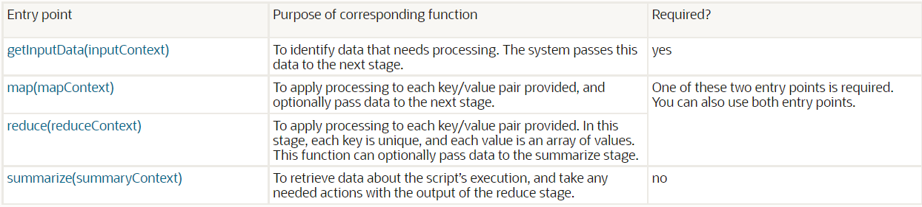
Map/Reduce Entry Points
Type
Suitelet Example

Slide 31
Day 7- Suitelet Script
Suitelet Scripts
Type
Suitelet Example

Slide 32
Suitelet
Suitelets are server-side scripts that operate in a request-response model. They are invoked by HTTP GET or POST requests to system generated URLs.
Suitelets are used to create the additional custom NetSuite pages.
Suitelets are also used to get the information at backend .

Slide 33
Suitelet
When building Suitelets, developers can use Suite Script UI Objects to create custom pages that look like NetSuite pages. Suite Script UI objects encapsulate the elements for building NetSuite-looking portlets, forms, fields, sublists, tabs, lists, and columns.

Slide 34
Back end Suitelet Uses
Providing a service for backend logic to other Suite Scripts, or to other external hosts outside of NetSuite
Offloading server logic from client scripts to a backend Suitelet shipped without source code to protect sensitive intellectual property

Slide 35
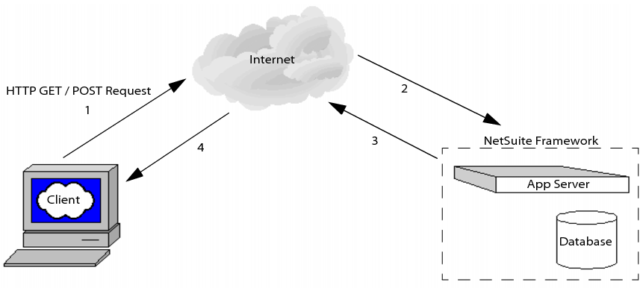
Suitelet Script Execution

Slide 36
External Available Suitelet
Suite let can available only when set to Available Without Login on the Script Deployment page but only some of Suite Script API are supported.

Slide 37
UI access for Suitelet
if you want users to be able to access/launch a Suitelet from the UI, you can create a menu item for the Suitelet.
The following figure shows the Links tab on the Script Deployment page for a Suitelet. Select the Center where the link to the Suitelet will be accessible (for example, Customer Center, Vendor Center, etc). Next, set the Section (top-level menu tab) in the Center, then choose a category under the section. Finally, create a UI label for the link. Be sure to click Add when finished.

Slide 38
UI access

Slide 39
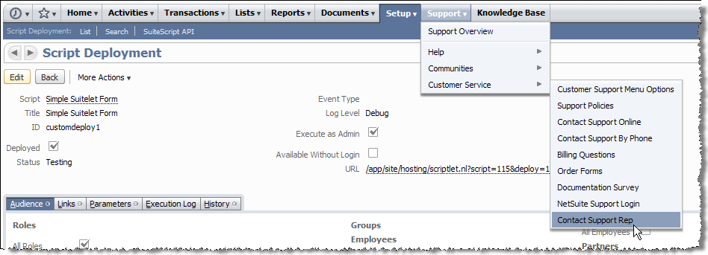
UI access

Slide 40
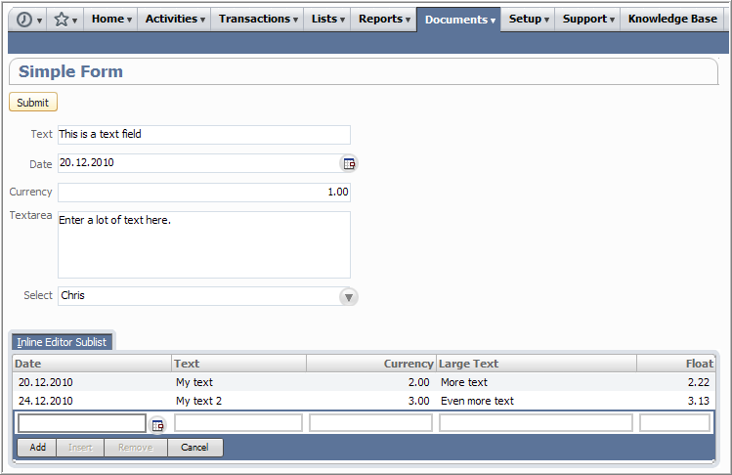
Suite let Forms

Slide 41
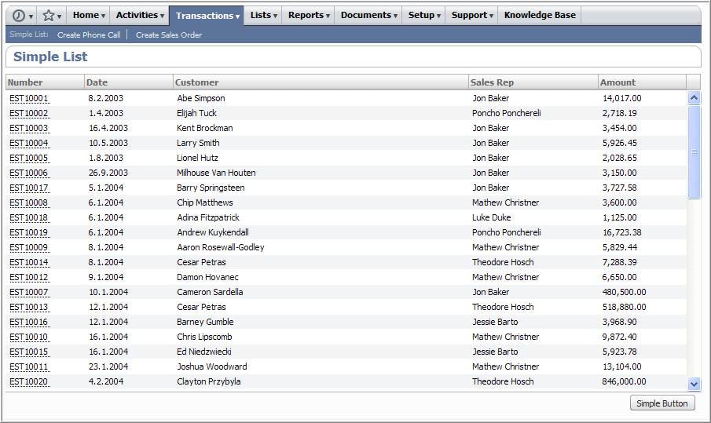
List Suitelet

Slide 42
Day 8- Schedule Script
Scheduled Script.
Scheduled script sample

Slide 43
Scheduled Script
Scheduled scripts run on the NetSuite server. Compared to user event scripts, scheduled scripts are given a higher limit of usage governance. Therefore, scheduled scripts are ideal for long running tasks and batch jobs.
Scheduled script can be invoked by API for immediate execution.

Slide 44
Scheduled Script Execution
Whether a scheduled script is executed “on-demand” for immediate execution, or it scheduled to run in the future, once a script has been placed into the NetSuite scheduling queue, it is executed serially on a per-company basis. In other words, there is a single queue used by all scheduled scripts in your company’s NetSuite account. As soon as one script completes, the next script in the queue is immediately executed.
A scheduled script may not run at precisely the time it was scheduled if there are multiple long-running scripts before it in your company’s queue. The first of your company’s scripts to be placed in the queue will be the first script to run. Although multiple scheduled scripts can exist in the queue, only a single script can be executed at any given time.

Slide 45
Scheduled Script Execution
For example, if your company has scheduled two scripts to start at 10:00 p.m., the second script that was also set to run at 10:00 p.m. will not start until the first script completes. Once the first script completes, the second script will execute immediately.

Slide 46
Scheduled Script Statuses
In Queue: The script is in the NetSuite scheduling queue and is waiting to be run.
In Progress: The script is currently running.
Completed: The script was successfully deployed and executed. The user must manually change the script’s deployment status to either Scheduled or Not Scheduled before the script can be run again.
Scheduled: If the script has been set to execute on a recurring basis, the script’s deployment status will appear as Scheduled after it executes. The script will then be re-run at its specified time(s).

Slide 47
Scheduling Script
Scheduled scripts with a deployment status set to Scheduled can be set to run once at a pre-defined time in the future, or they can be scheduled to run on a more regular daily, weekly, monthly, or yearly basis. Note that deployment times can only be scheduled in 30 minute intervals, for example 2:00 pm., 2:30 pm., 3:00 pm.

Slide 48
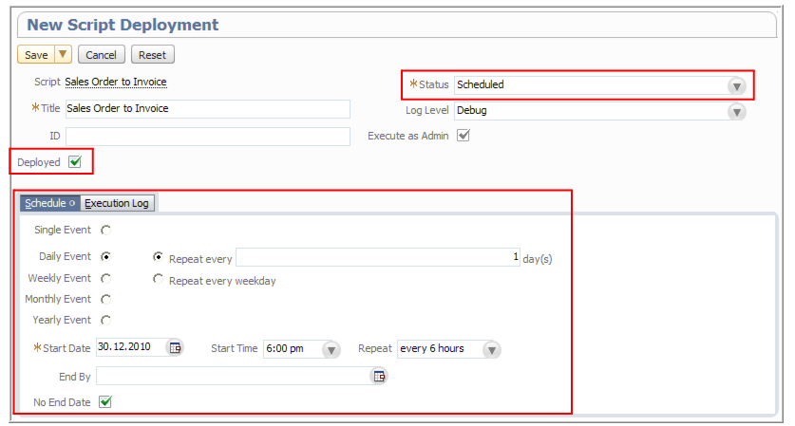
Scheduling Script

Slide 49
Scheduled Scripts Using nlapiScheduleScript
You can programmatically run a scheduled script using the nlapiScheduleScript API. Be sure that the script’s deployment status appears as either Not Scheduled or Completed on the Script Deployment page.
Using nlapiScheduleScript you can:
Place a currently executing scheduled script back into the scheduling queue.
Call another scheduled script from within a scheduled script. When the new script is called, it is then put into the scheduling queue.
Place a scheduled script into the queue from another script such as a user event script or a suitelet.

Slide 50
Scheduled Scripts Using nlapiScheduleScript
if nlapiScheduleScript is used in a scheduled script to call another scheduled script, instruction count limits are applied to eachscript separately, since (technically) you are running two different scheduled scripts. In other words, both “scheduled script A” and “scheduled script B,” which was called by “scheduled script A” can each contain 10,000 units.

Slide 51
Recovery Points in Scheduled Scripts
NetSuite gives developers the ability to create recovery points in scheduled scripts when a failure occurred in script.
These recovery points allow the state of the script at a certain point to be saved. In the event of an unexpected system failure, the script can be restarted from the last successful recovery point

Slide 52
Recovery Points in Scheduled Scripts
To set a script recovery point, use nlapiSetRecoveryPoint(). When the system restarts, the script will resume where it left off.
Developers can also use nlapiYieldScript(). In addition to setting a recovery point, this API places the script back into the scheduled script queue. Once the script moves to the front of the queue for processing, it begins its execution from the specified recovery point.

Slide 53
Day 9- RESTlet
RESTlet script.
RESTlet script example.

Slide 54
RESTlet
RESTlets, a new type of server Suite Script. This new API is a lightweight, flexible, and standards-based framework that provides an alternative to SOAP-based Web services. Developers can use RESTlets to define custom RESTful integrations with NetSuite.

Slide 55
RESTlets
RESTlets are a form of Web services integration. Each RESTlet is a server-side script that operates in a request-response model, and is invoked by an HTTP request to a system-generated URL.
RESTlets follow the principles of the REST architectural style and use HTTP. They use HTTP verbs, HTTP headers, HTTP status codes, URLs, and standard data formats.
RESTlets support the entire Suite Script API and general Suite Script features such as debugging
RESTlets provide the following additional benefits:
Support of stateless requests and responses between client and server
Built-in authentication using user credentials in HTTP header.

Slide 56
Day 9- Portlet Script and Bundle Installation Script
Portlet Scripts
Portlet Script examples

Slide 57
Portlet Scripts
Portlet scripts can be used to define and publish custom dashboard content.
List , Form , HTML and Links are portlet script types.

Slide 58
Portlet Types
LIST - A standard list of user-defined column headers and rows.
FORM - A basic data entry form with up to one submit button embedded into a portlet This type of portlet supports APIs to refresh and resize the portlet, as well as the use of record-level client-side script to implement validation.
HTML - An HTML-based portlet, the most flexible presentation format used to display free-form HTML .
LINKS - This default portlet consists of rows of simple formatted content.

Slide 59
Portlet Script
Be aware that the portlet type (LIST, FORM, HTML, LINKS) is not actually passed as a value in the portlet script itself, rather it is defined on the portlet Script record page (see figure below). Once you create your portlet .js file, you will load your .js file into the file cabinet, create a new script record for your file (Setup > Customization > Scripts > New > Portlet), and then select the portlet type from the Portlet Type drop-down menu.

Slide 60
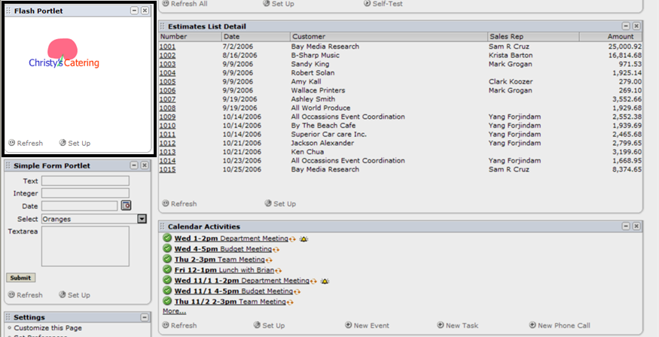
Portlet Script Examples

Slide 61
Day 11 Mass Update Script and Workflow Action Script
Mass Update: Used to perform custom updates to record fields that are not available through general mass updates. Mass/update scripts are executed on demand only using the Perform Update button on the Mass Update Results Preview page
Workflow Action: Workflow action scripts allow you to create custom Workflow Actions that are defined on a record in a workflowWorkflow action scripts are also useful when you need to create custom actions that execute complex computational logic that is beyond what can be done with the built-in actions

Slide 62
Day 12- Debugging Script
You can use the Suite Script Debugger to debug server scripts. Server script types are user event, Suitelet, scheduled, and portlet scripts.
Scripts which are in testing mode will debug in debugger(Suitelets or UE)

Slide 63
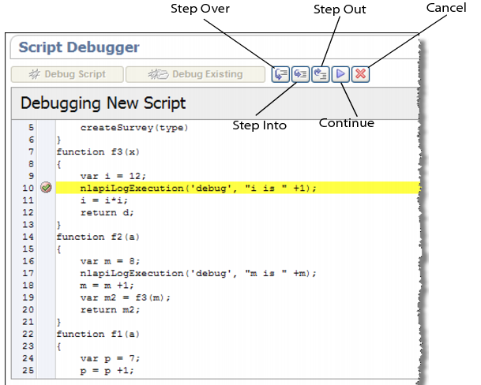
Debugger

Slide 64
Debugger UI
There are five Debugger buttons that can be used to control/resume script execution once the Debugger stops at a particular line:
Step Over: Resumes execution from the current line and stops at the next line (even if the current line is a function call).
Step Into: Resumes execution from the current line and stops at the first line in any function call made from the current line.
Step Out: Resumes execution from the current line until the end of the current function, and stops at the first line following the line from where this function was called -or- until the next break point -or- until the program terminates (either by error or by normal completion).
Continue: Resumes program execution from the current line until the next break point -or- until the program terminates
Cancel: Aborts execution of the program from the current line.

Slide 65
Day 13- Best Practices
Code organization and structure
Naming conventions
Commenting
Error and exception handling
Script parameters
Do not hard code values(URL, ID, Static)
Logging

Slide 66
Scripts Usage
Schedule Script - 10,000
User Event Script - 1,000
Client Script - 1,000
Suitelet Script - 1,000
Restlet Script - 5,000
Portlet Scripts - 1,000
MassUpdate Script- 1,000 per Each record of the script
Bundle Installation Scripts - 10,000

Slide 67
Day 14- Q & A
?

Slide 68
Day 15- Final Review and Conclude
Thank You!

